Slide 1

Quantum Machine Learning Approach for LoRa Path Loss Prediction
Review 2: model Implementation & results
GORANTLA BHAVITHA – 22BCE20496
GARAGA KALYAN RAM – 22BCE8814
GUIDE: DR. PRASHANTH RAGAM

Slide 2
Objectives
Problem Statement:
The Connectivity Gap: In remote or challenging real-world environments, standard Wi-Fi and Cellular infrastructure are often absent or unstable, making LoRa the critical alternative for IoT communication.
The "Weather Wall": Real-world LoRa signal strength is highly vulnerable to complex atmospheric shifts. Variables like Temperature, Humidity, and Distance do not act in isolation; they constantly interact to degrade the signal in highly unpredictable ways.
The Classical Bottleneck: Traditional path loss equations and standard AI models struggle to accurately map these overlapping environmental interactions without massive datasets. They cannot reliably predict sudden signal drops, leading to critical data loss in emergency monitoring scenarios.
Project Goal:
To develop a Quantum Machine Learning (QML) regression model
that accurately predicts LoRa signal degradation.

Slide 3
Knowledge Gained
LoRa Communication Physics:
Studied the impact of Spreading Factor (SF) and Bandwidth (BW) on signal range and decoding.
Understood the relationship between RSSI (Signal Strength) and SNR (Signal Quality) in noise-heavy environments.
Path Loss Modeling:
Analyzed the Free Space Path Loss (FSPL) equation: PL = P_t - P_r + G_{total}.
Identified key variables: Distance, Frequency, and Environmental attenuation.
Hardware Control:
Mastered MicroPython for Pycom architecture.
Implemented raw LoRa socket programming (Layer 2) for direct packet inspection.

Slide 4
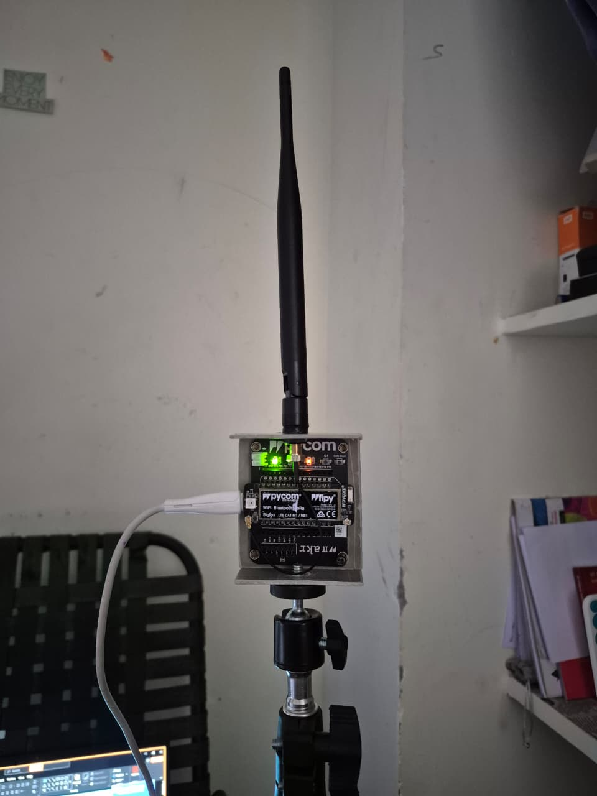
System Architecture (Hardware Setup)
Hardware Stack:
Transmitter (Node): Pycom FiPy running in roaming mode.
Receiver (Gateway): Pycom FiPy acting as a Base Station connected to a logging terminal.
Communication Protocol:
Frequency: 868 MHz (EU868 / IN865 Region).
Mode: Raw LoRa (P2P) for granular control over packet stats.
Antenna Gain: 8 dBi Total (G_{tx} + G_{rx}).
Operational Logic:
Transmitter broadcasts packets every 3 seconds.
Receiver captures packet, extracts RSSI/SNR, and computes Path Loss instantly.

Slide 5
Smart Data Collection Framework
Automated Environmental Tagging:
Integrated Wi-Fi + Open-Meteo API into the Receiver firmware.
Workflow: On startup, the system automatically fetches live local weather (Temp, Humidity, Wind Speed)
before initiating LoRa listeners.
Benefit: Removes manual error and ensures every data point is tagged with accurate environmental context.
Distance Tagging Strategy:
Implemented a "Reset-Marker" protocol to tag ground-truth distance in log files without expensive GPS hardware.

Slide 6
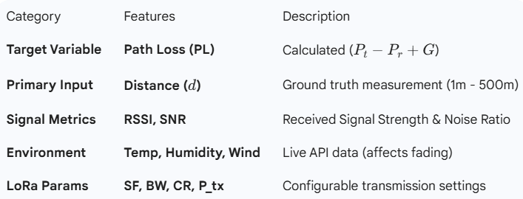
Dataset Structure
We are building a custom dataset with 4 Main Features for the QML Model:
Distance, Temperature, Humidity, Spread Factor

Slide 7
FINALIZED DATASET STRUCTURE
Initial Collection: Gathered a custom dataset featuring 11 distinct environmental and transmission variables.
Optimized Quantum Model Inputs (Features - X): After feature selection, the final model utilizes 4 primary variables:
Distance
Temperature
Humidity
Spreading Factor (SF)
Target Variable (y): Path Loss (Real dBm)
Data Splitting Strategy:
70% Training Data
30% Testing Data (Kept completely hidden from the model to test true real-world accuracy).

Slide 8
System Validation (Proof of Concept)
Successful Hardware Integration:
Transmitter and Receiver successfully paired in P2P LoRa mode.
Verified real-time packet reception with RSSI & SNR extraction.
Firmware Validation:
Auto-Calibration: System successfully resets and identifies "Start Points" using the
Reset-Marker protocol.
Live Environment Tagging: Wi-Fi module successfully fetches and logs live Temperature/Humidity
before every session.
Pilot Test (Lab Scale):
Conducted short-range stability tests (0-5m).

Slide 9
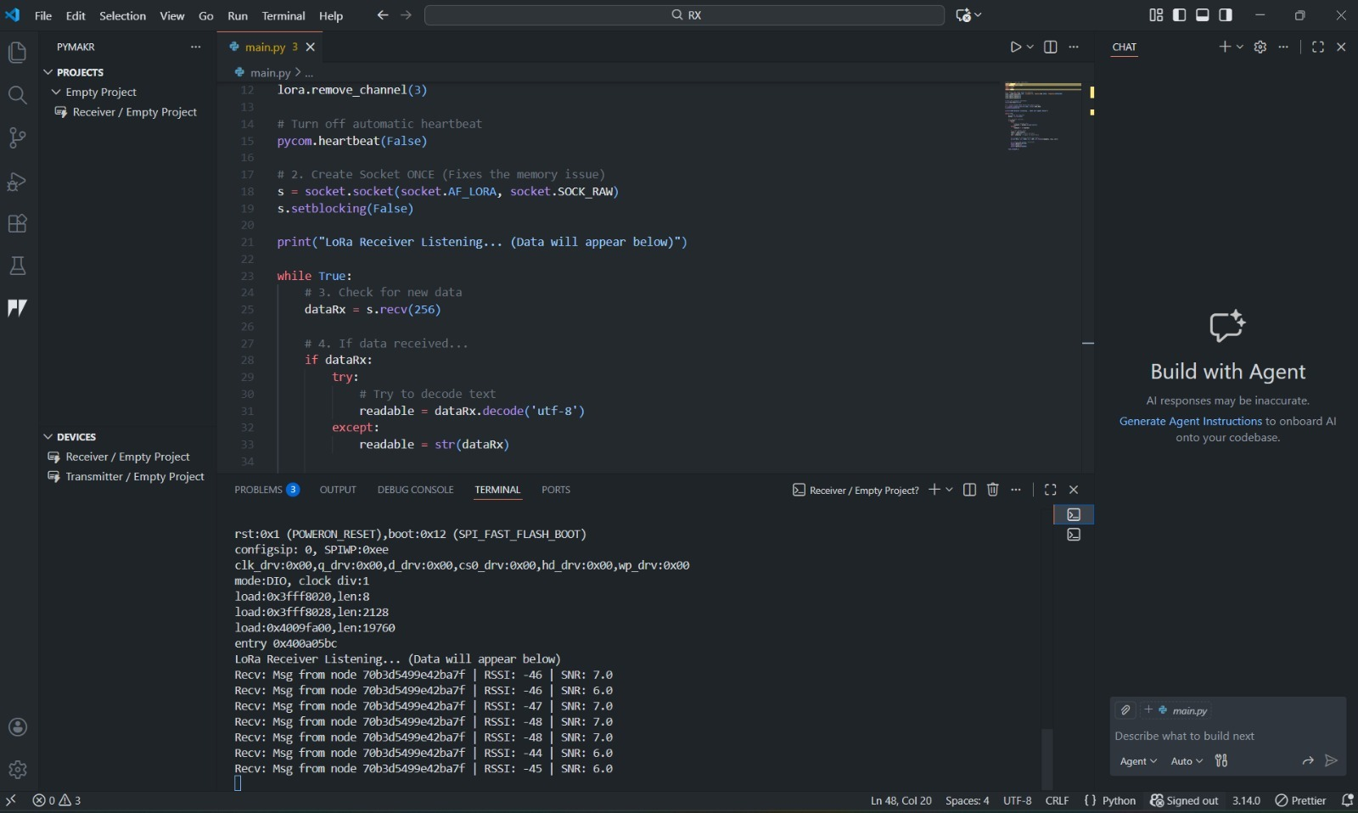
Status: System is calibrated and ready for large-scale field deployment.

Slide 10
Data Collection Plan & PROJECT PHASES
Phase 1: Initial Research & Setup (Completed)
Phase 2: Field Data Collection (Completed)
Goal: 500+ Data points.
Result: Successfully exceeded the target by collecting 987 real-world data points at Prakasam Barrage.
Phase 3: Data Processing & Model Training (Completed)
Data preprocessing and scaling finalized.
Quantum Regression Model successfully built, trained, and evaluated.

Slide 11
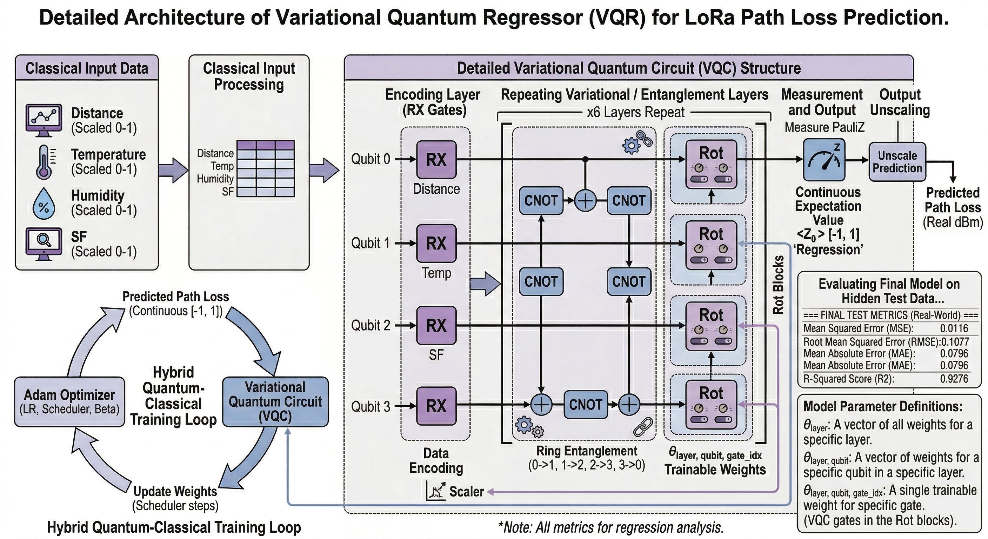
QUANTUM MODEL ARCHITECTURE

Slide 12
Quantum model architecture
Core Model: Quantum Neural Network(QNN) or Variational Quantum Regressor (VQR)
Frameworks Used: Built using PyTorch and simulated with PennyLane.
Circuit Design (The "Quantum Brain"):
Qubits: 4 (Mapped directly to our 4 primary input features).
Circuit Depth: 6 Layers.
Why 6 Layers? This specific depth was chosen to significantly enhance the model's expressivity, allowing it to capture complex interactions between weather and distance without memorizing the data.

Slide 13
Hyperparameter tuning and training setup
Optimizer: Adam Optimizer
Initial Learning Rate: 0.02
Learning Rate Scheduler: StepLR
Function: Dynamically cuts the learning rate by 50% every 50 epochs. This allows the model to learn rapidly at the beginning, and use microscopic fine-tuning steps at the very end.
Training Loop Configuration:
Total Epochs: 250
Batch Size: 16 (A smaller batch size provides frequent weight updates, helping the quantum model escape shallow error traps).

Slide 14
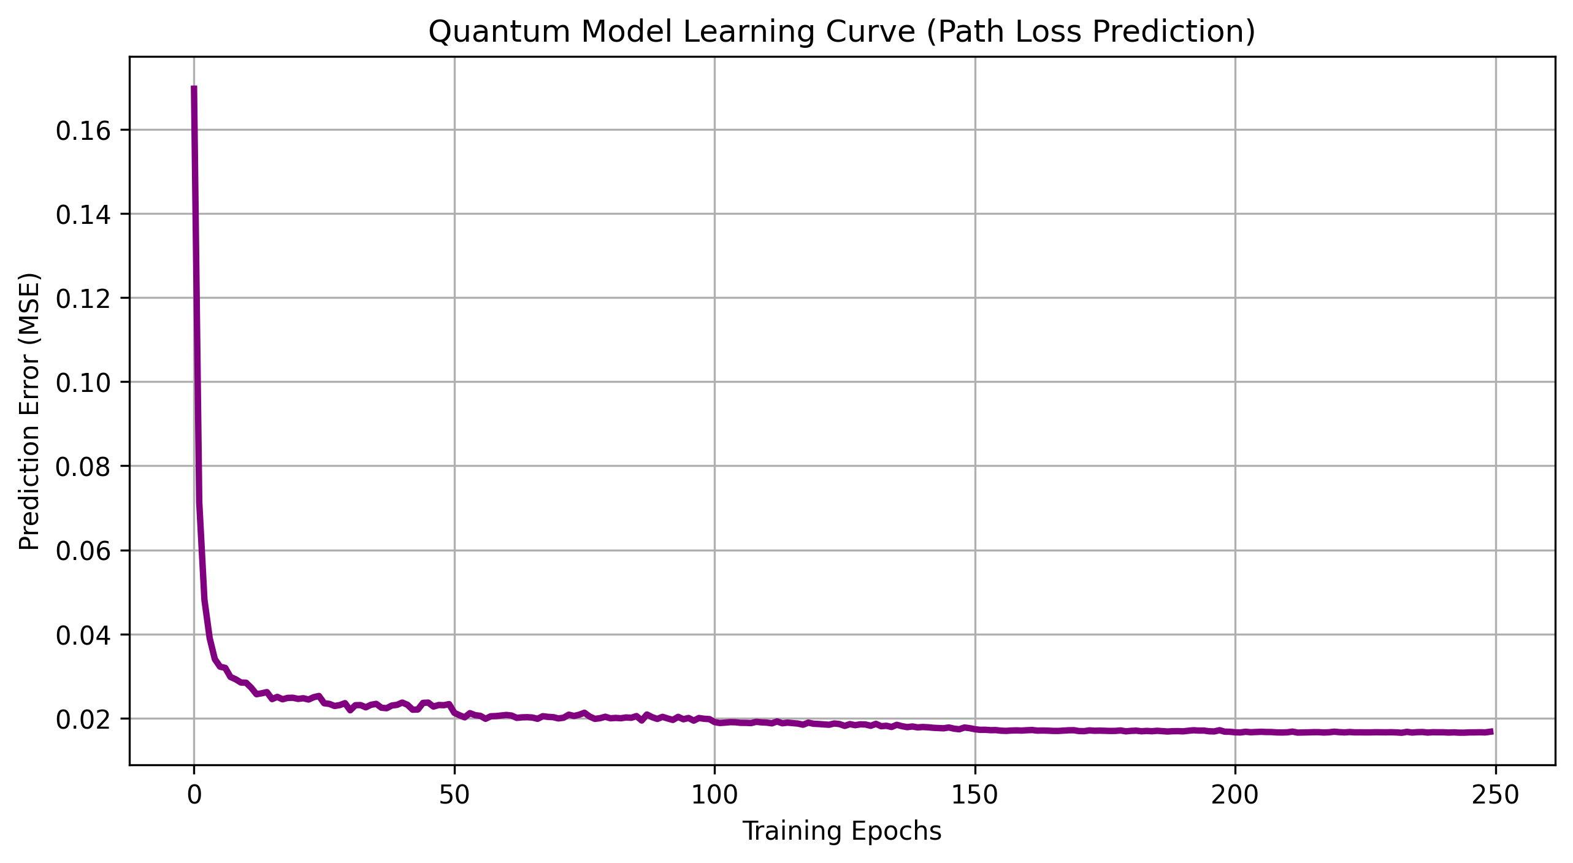
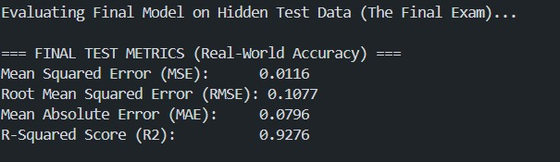
Final System Validation & Results

